Slide 1

DSCI 6007-Final Project – Showcase
Team Members: Stuti Bimali Priyanka Singh
Lakshman Rajith Title:
Real-Time and Batch ETL Pipeline for E- Commerce Price Drop
April 30th , 2025
Notes:
For Educators: You can use this template to help your students effectively present and communicate their project to a broader audience. Your students can also use this presentation as a portfolio of their work to demonstrate their cloud skills.
The presentation structure is listed below. The total time may vary depending on the activity you want to conduct. For example, you may want your students to provide high-level walkthrough of their final solutions versus deep-dive into why or how they chose certain services and the steps of building their architectures.
Suggested timing for a 15-minute presentation:
Introduction – 30 seconds
Business scenario overview – 1 minute
Solution overview – 5 minutes
Architecture diagram of the solution – 2 minutes
Demo – 5 minutes
Lessons learned – 1.5 minutes

Slide 2

CONTENT
Introduction
Business scenario overview
Solution overview
Crisp-DM Methodology
Architecture diagram of the solution
Difficult Challenges Faced
Results Achieved
Lessons learned
Demo

Slide 3



TEAM
STUTI BIMALI
PRIYANKA SINGH
LAKSHMAN RAJITH
Data Scientist (Team Lead)
Section 1
Data Developer
Section 2
Data Engineer
Section 2

Slide 4
Business scenario overview
Problem / Opportunity Statement
E-commerce platforms experience rapid and frequent price changes.
Businesses and consumers struggle to track and act on these changes promptly.
Manual tracking methods are inefficient and reactive.
Notes:
Define the problem or opportunity that you are addressing. Include pictures, figures, and statistics to help the audience better conceptualize the problem or opportunity.
Specify who your users or customers are and what pain points they are experiencing.
For example: “Users complain that the student admissions department website is too slow and isn’t always available.”
Also, list any specific business requirements that you are addressing.
For example: “Improve the experience for users. The web application can be deployed to the AWS Cloud. The application must be highly available, scalable, load balanced, secure, and performant architecture that can support thousands of users.“
Note:
An above-bar overview succinctly defines the problem and opportunity statement. For example: “Customers with media files, such as retail companies, need an easy and cost-effective way to analyze photos and videos of their inventory.”
A below-bar overview is too verbose, technical, or not specific. For example: “The most common media files are .jpg and .mp4. Companies have media files of their inventory.”

Slide 5
Business scenario overview
Solution Requirements
Real-time ingestion of pricing data.
Automated ETL to clean and structure incoming data.
Predictive analytics to forecast price drops.
Interactive visualization for actionable insights.
Cloud-native, scalable, and modular system architecture.
Notes:
Define the problem or opportunity that you are addressing. Include pictures, figures, and statistics to help the audience better conceptualize the problem or opportunity.
Specify who your users or customers are and what pain points they are experiencing.
For example: “Users complain that the student admissions department website is too slow and isn’t always available.”
Also, list any specific business requirements that you are addressing.
For example: “Improve the experience for users. The web application can be deployed to the AWS Cloud. The application must be highly available, scalable, load balanced, secure, and performant architecture that can support thousands of users.“
Note:
An above-bar overview succinctly defines the problem and opportunity statement. For example: “Customers with media files, such as retail companies, need an easy and cost-effective way to analyze photos and videos of their inventory.”
A below-bar overview is too verbose, technical, or not specific. For example: “The most common media files are .jpg and .mp4. Companies have media files of their inventory.”

Slide 6
Solution overview
A real-time and batch ETL pipeline using AWS services and Docker, integrating ML and Power BI for dynamic pricing insights.
Design Considerations
Use Cases
Scalable cloud-native architecture (S3, Glue, Athena)
Lightweight ML deployment with Stream lit on EC2
Live dashboards through Athena ODBC to Power BI
Businesses optimize pricing strategies.
Consumers predict the best buying time.
Analysts explore historical price behaviors.
Notes:
Explain at a high level what you have built.
For example: “I built a web application for a company to host their blog.“
Talk about why you chose certain parts of the solutions and any tradeoffs that you made. Focus on how you designed the solutions and how you applied the AWS Well-Architected Framework as part of the process (AWS Well-Architected Framework: https://docs.aws.amazon.com/wellarchitected/latest/framework/welcome.html).
For example: “I configured load balancers and auto scaling to make the application highly available and reliable.”
Include the use cases that you are addressing. Think about who your users are and how they would want to interact with your solution to solve their problem.
For example: “Users can view, upload, edit, and delete blog posts. Administrators can approve blog posts.”
Talk about the use cases that you addressed as part of the minimum viable product (MVP) that you scoped and built.
Note:
An above-bar description is concise and includes the most important benefits. For example: “The solution allows customers to quickly upload, store, and search large catalogs of images and videos in Amazon S3.”
A below-bar description is too detailed or not specific. For example: “Our solution analyzes media files.”

Slide 7
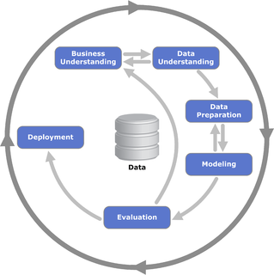
Crisp-DM Methodology

Slide 8
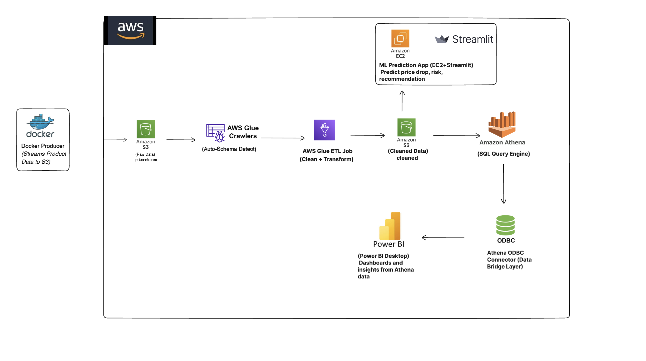
Architecture diagram of the solution
Notes:
Use the following resources to create a diagram of your application architecture:
AWS Architecture Icons at https://aws.amazon.com/architecture/icons. This page includes diagram assets as well as links to drawing and diagramming tools that you can use.
As you walk through the architecture, make sure that you relate back to the business requirements and the AWS Well-Architected Framework (https://docs.aws.amazon.com/wellarchitected/latest/framework/welcome.html).
You can also go more in depth about the design considerations and trade-offs that you made.

Slide 9
Difficult Challenges Faced
Real-time Docker Streaming Stability: Maintaining stable, continuous data flow from Docker container to S3 without losing records was tough, especially with intermittent API rate limits and handling connection retries. | Schema Evolution in AWS Glue: As incoming product data had dynamic changes (new columns like discount rates or missing fields), configuring AWS Glue to adapt automatically without failing the ETL job was a major challenge.
ODBC Authentication Complexities: Establishing a live ODBC bridge between Athena and Power BI involved handling credential expiry issues and query timeout settings, which needed manual driver tuning and retries. | Resource Constraints on EC2 Deployment: Deploying a real-time ML model API with Streamlit on a basic EC2 instance was tricky due to memory limits, requiring us to optimize the Streamlit app and model loading size to avoid crashes.

Slide 10
Results Achieved
Delivered a robust, modular real-time and batch ETL pipeline
Enabled live price monitoring and predictive ML insights
Provided dynamic dashboards for real-time business analytics
Built a scalable, production-ready cloud architecture

Slide 11
Lessons Learned
Key Lessons and Experiences
Designed a scalable, modular, and cloud-native pipeline combining real-time and batch processing.
Solved challenges related to AWS permissions, ETL job optimization, and EC2 deployment security.
AWS service documentation, Streamlit deployment tutorials, Power BI ODBC integration guides.
Mastered Docker containerization, AWS Glue ETL workflows, Streamlit app deployment, and Power BI live dashboard creation.
Automate data refresh with AWS Lambda triggers.
Expand ML model with advanced features and tuning.
Integrate AWS Redshift for large-scale warehousing and deeper analytics.
Valuable Resources
Skills Developed
Next Steps for Enhancement
Notes:
Describe any challenges that you encountered and how you overcame those challenges.
For example: “I got stuck when I was creating an EC2 instance to host the application. I used the resources that were listed in the instructions to walk myself through the process to create a new EC2, and I was able to complete the task. The links to labs in other courses were very helpful.”
Describe any new skills that you learned from this project.
For example: “I learned how to set up auto scaling correctly so my resources were automatically adjusted and allocated at the lowest possible cost.”
Discuss any future, out-of-scope use cases in the next steps.
For example: “I would like to scale out the web application so that multiple departments can use it.”

Slide 12
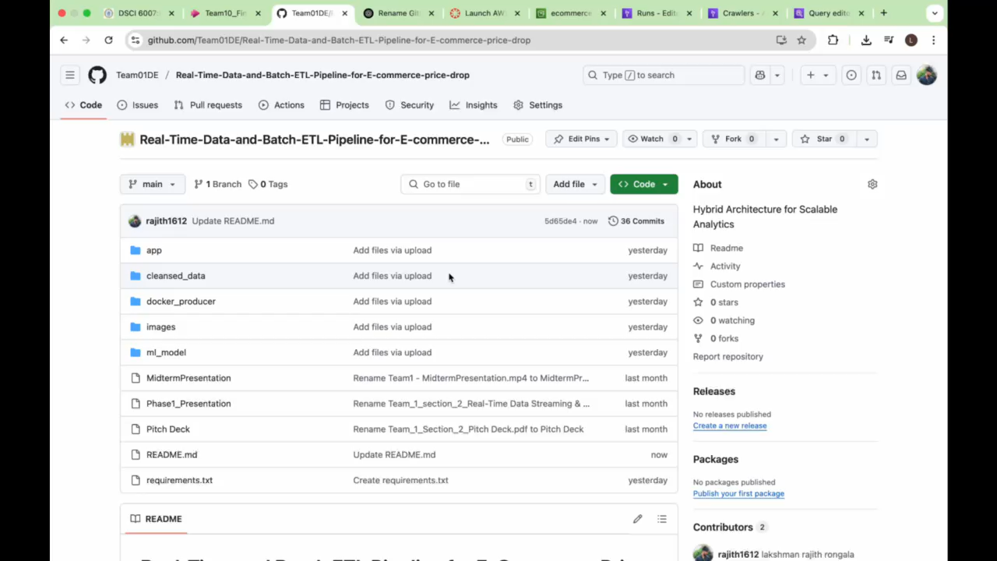
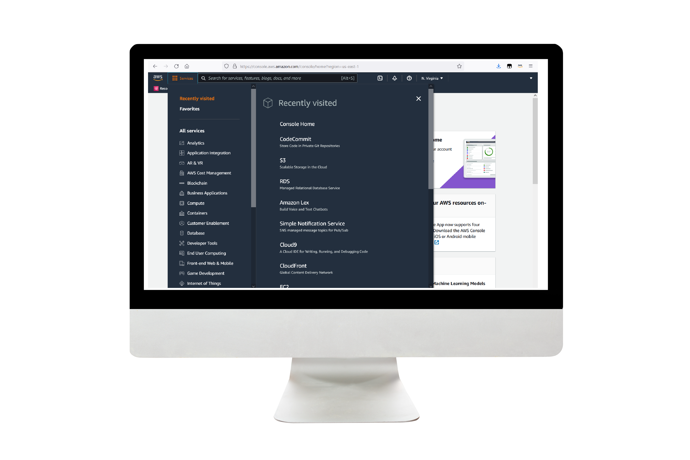
Demo
GITHUB : https://github.com/Team01DE/Real-Time-Data-and-Batch-ETL-Pipeline-for-E-commerce-price-drop
Notes:
For the demo, guide the audience through the two to three most important benefits of the solution and how it addresses the requirements.
Your demo materials can be screen captures, recordings, a link to your final solution, and/or a link to AWS console.

Slide 13
Thank you

